Slide 1

CMR Technical Campus Department of CSE
Industrial Oriented Mini Project
Project Title: Automated Resume Analysis & Skill Matching Website using NLP
Project Supervisor:​
Name:​ Dr. J. Narasimharao
Designation: Associate Professor
Presented By:
Batch No: 01
H. No: 227R1A0559 Name: V VENKATA SAI ANAND
H. No: 227R1A0501 Name: A AMBIKA
H. No: 227R1A0531 Name: K SIRIVALLI

Slide 2
Index
Department Vision and Mission
Abstract​
Introduction​
Literature Review​
Problem Definition​
Objectives​
Requirement Analysis​
Methodology​
Design/Architecture​
References​

Slide 3
Department Vision
To provide quality education and a conducive learning environment in computer engineering that foster critical thinking, creativity, and practical problem-solving skills.
Department Mission
To educate the students in fundamental principles of computing and induce the skills needed to solve practical problems.
To provide State-of-the-art computing laboratory facilities to promote industry institute interaction to enhance student’s practical knowledge.
To inculcate self-learning abilities, team spirit, and professional ethics among the students to serve society.

Slide 4
Abstract
Online job postings receive a large number of applications in a short time, making manual resume screening time-consuming, costly, and often unfair. Many suitable candidates are overlooked, leading to mismatches in hiring. To address this, we propose an automated system that uses Natural Language Processing (NLP) to extract key details like skills, education, and experience from unstructured resumes, creating a concise summary. By removing irrelevant information, the screening process becomes more efficient. The system then employs a vectorization model with cosine similarity to rank resumes based on job relevance, enabling recruiters to identify the best-fit candidates quickly and accurately.

Slide 5
Introduction
In the present system the candidate has to fill each and every information regarding there resume in a manual form which takes large amount of time and then also the candidates, are not satisfied by the job which the present system prefers according to there skills. Let me tell you a ratio of 5:1 means, If 5 people are getting job than out of that 5, only a single guy will be satisfied by his/her job. Let me tell you an example : If i am a good python developer and particular company hired me and they are making me work on Java so, my python skills are pretty useless. And on the other hand if there is vacant place in a company so according to owner of the company he/she will prefer a best possible candidate for that vacancy. So our system will act as a handshake between this two entities. The company who prefer the best possible candidate and the candidate who prefers the best possible job according to his or her skills and ability.

Slide 6
Literature Review​
First Generation Hiring Systems: Jobs were advertised via newspapers and TV, requiring manual resume screening, which was time-consuming.
Second Generation Hiring Systems: Consultancy firms emerged, requiring candidates to submit resumes in specific formats. Keyword-based searches helped match applicants, but format restrictions limited flexibility.
Existing System: Uses Data Envelopment Analysis (DEA) to evaluate candidates based on achievements. The process involves performance assessment, tradeoff analysis, and clustering.
Limitations: The existing system lacks accuracy and efficiency, highlighting the need for improvement.

Slide 7
Problem Definition​
The core problem is identified as the limitations of current hiring systems.
These systems are often inflexible, inefficient, and time-consuming.
A specific issue is that they require candidates to fill out online forms, which may not always provide accurate or genuine information about the candidate.
The proposed system aims to address these problems by offering a more flexible and efficient solution.
This includes allowing candidates to upload their resumes in any format and extracting candidate information from resume profiles to obtain more accurate data.

Slide 8
Objectives
The primary objective of the system is to create a better connection between companies and candidates.
It aims to serve as a "handshake" between companies seeking the best possible candidates and candidates seeking the best possible jobs that align with their skills and abilities.
Additional objectives include saving time for both candidates and client companies.
The system also aims to provide more accurate and efficient resume analysis and skill suggestions.

Slide 9
Requirement Analysis​
Hardware Requirements:
The system requires an i3 processor or above.
It also needs 4GB of RAM.
A hard disk with 40GB of storage is necessary.
Software Requirements:
Operating System: Windows 8
Coding Language: Python 3.7
DEPENDENCIES:
Django, Spacy, Pyresparser, Requests, and PDFMiner for data extraction, processing, and resume analysis.

Slide 10
Methodology
The core methodology leverages Natural Language Processing (NLP) to enhance resume processing.
NLP is utilized to parse resumes and extract relevant information, specifically using the SpaCy resume parser.
A Python backend is responsible for ranking resumes based on predefined criteria.
The extracted data is efficiently stored in a database for further analysis and retrieval.

Slide 11
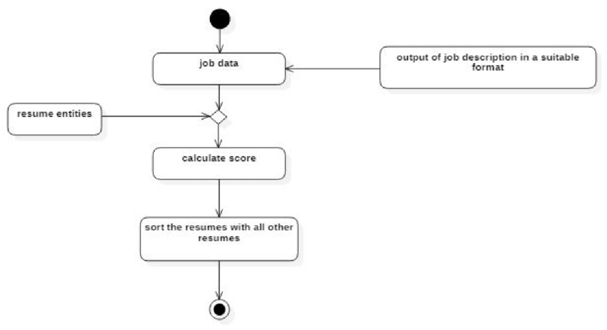
Design/Architecture​

Slide 12
References
[1]. Pradeep Kumar Roy, Vellore Institute of Technology, 2019. A Machine learning approach for automation of resume recommendation system, ICCIDS 2019. 10.1016/j.procs.2020.03.284.
[2]. Thimma Reddy Kalva, Utah State University, 2013. Skill-Finder: Automated Job-Resume Matching system. 3]Yong Luo, Nanyang Technological University, 2018. A Learning- Based Framework for automatic resume quality assessment, arXiv:1810.02832v1 cs.IR].
[3]. Suhjit Amin, Fr.Conceicao Rodrigues Institute of Technology, 2019. Web Application for Screening resume, IEEE DOI: 10.1109/ICNTE44896.2019.8945869.
[4]. Tejaswini K, Umadevi V, Shashank M Kadiwal, Sanjay Revanna, Design and Development of Machine Learning based Resume Ranking System (2021), DOI: https://doi.org/10.1016/j.gltp.2021.10.002.
[5]. Riza tana Fareed, rajah V, and Sharadadevi kaganumath, “Resume Classification and Ranking using KNN and Cosine Similarity” In 2021 International Journal of Engineering Research & Technology (IJERT), ISSN: 2278- 0181, Vol.10.
[6]. Suhas Tangadle Gopalakrishna, Vijayaraghavan Varadharajan, “Automated Tool for Resume Classification Using Semantic Analysis”, International Journal of Artificial Intelligence and Applications (IJAIA), Vol. 10, No.1, January 2019

